Slide 1
Offensive text classification on OLID dataset

Slide 2


Agenda
A
Introduction
Comparisons
Accuracy score
Conclusion

Slide 3
Introduction
The purpose for this investigation was to create a predictive model for classifying offensive tweets using the OLID dataset
Three sets – Train set, Test Set, Validation set
Divided into 4 tasks:
Task 1 and 2: Model selection and performance test
Task 3: Subsets of the train dataset – 25%, 50%,75%, 100%
Task4 : Prediction
Results obtained were pretty good as compared to other algorithms such as Decision tree, Naïve bayes.

Slide 4
Comparison with plots and tables

Slide 5
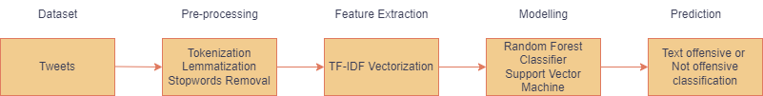
Block diagram of pipeline

Slide 6
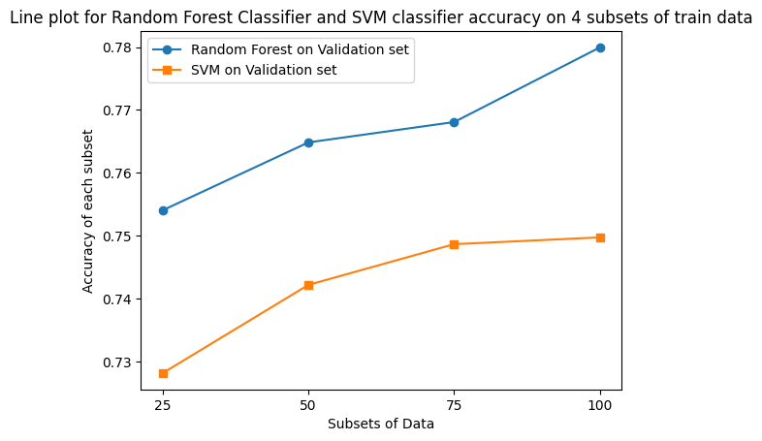
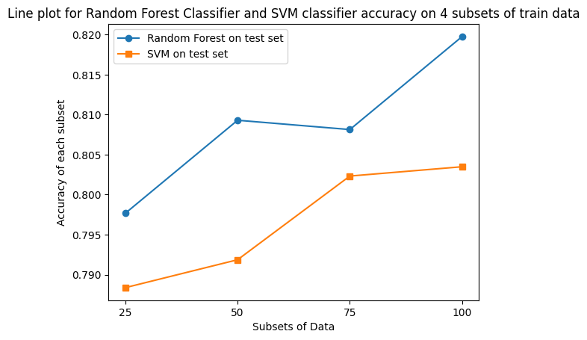
RF and SVM accuracy on Validation set

Slide 7
RF and SVM accuracy on test set

Slide 8
Performance Metrics : Accuracy score
“
”

Slide 9
Performance : Accuracy
The accuracy score obtained for the classifiers is pretty good.
The Random Forest classifier gave an accuracy score of 81% on the test set , whereas 77% on the validation set with 100% of the train data.
The Support Vector Machine classifier gave an accuracy score of 80% on the test set , whereas 74% on the validation set with 100% of the train data.

Slide 10
Conclusion
In conclusion, offensive text classification is an important work since it assists in identifying and filtering out harmful or improper content from social media platforms.
The findings discussed above suggests that both classifiers are successful at identifying offensive texts and have the potential to be enhanced further by employing more advanced approaches such as deep learning

Slide 11
Thank you

